Slide 1
Neural Networks

Slide 2
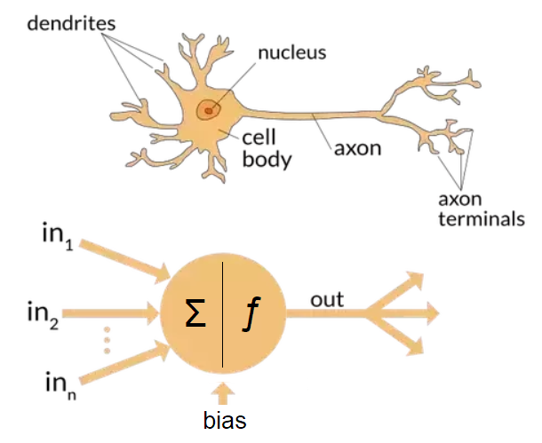

Slide 3
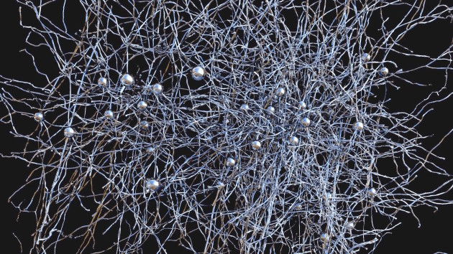

Slide 4
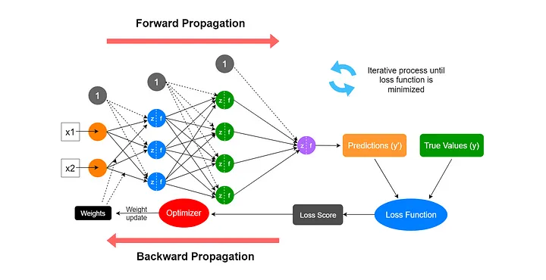
Notes:
Source: https://medium.com/data-science-365/overview-of-a-neural-networks-learning-process-61690a502fa

Slide 6
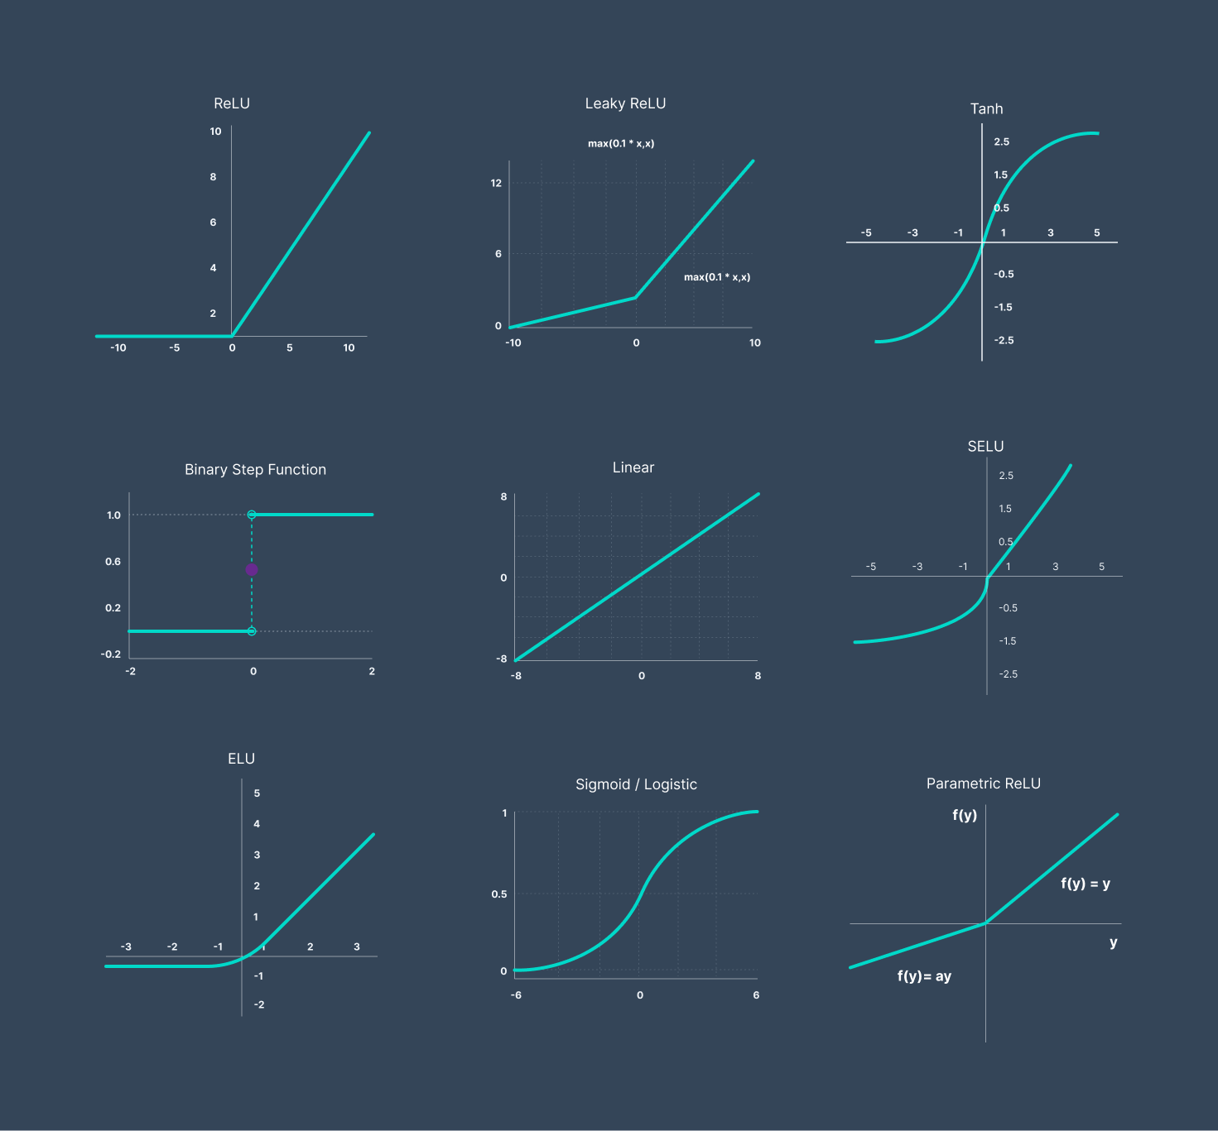
Activation Function

Slide 7
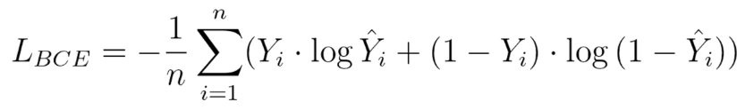
Loss Function
Get a numerical measurement of how good/ bad your model is doing
Regression
MAE/ MSE Loss
Binary cross entropy Loss
Categorical cross entropy

Slide 8
Optimizer
Update the weights of the model
Uses the gradients calculated for tensor

Slide 9
Other Fancy words
Dropout:
Randomly shutdown portions of network so that network is more reliant
Normalization
Make the weights proper to avoid any degradation of model

